Slide 1

DROWSY DRIVER
DETECTION
presented By :Mohamed Sherif
Mohamed Osama
Ali Zorkany
Yousef el Ghazali

Slide 2

INTRODUCTION
In this project, we developed a drowsy driver detection system using traditional image processing techniques and facial landmark analysis. The system monitors the eyes and mouth in driver images to compute EAR (Eye Aspect Ratio) and MAR (Mouth Aspect Ratio), which are key indicators of drowsiness. This solution runs on a Jupyter Notebook and demonstrates how computer vision techniques can contribute to road safety

Slide 3
TECHNOLOGIES & LIBRARIES
Python: programming language
OpenCV: Image enhancement (CLAHE, grayscale) and visualization.
NumPy: Numerical operations and geometry calculations
Matplotlib: Displaying processed images in the notebook.
Pandas: Data handling and analysis
glob: Reading multiple image files efficiently.
MediaPipe: Real-time face mesh detection and landmark extraction.

Slide 4
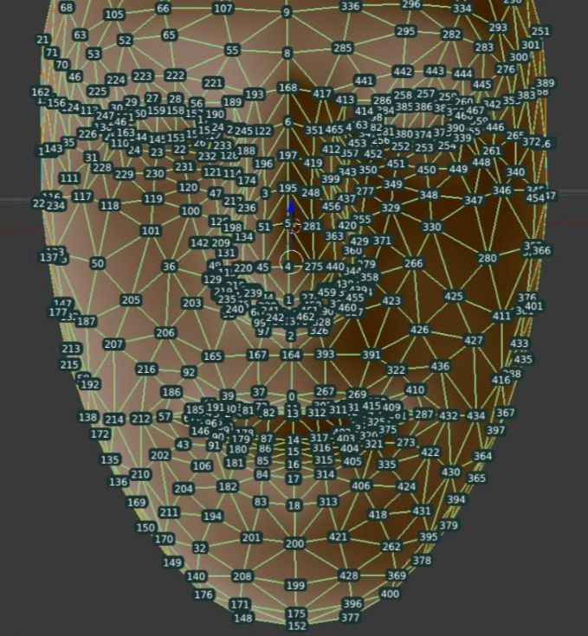
MEDIAPIPE LANDMARKS
What is Mediapipe:
MediaPipe is an open-source framework by Google that provides real-time face and hand landmark detection
In our project:
It was used to locate eye and mouth landmarks.
We used those coordinates to calculate EAR and MAR.

Slide 5
WORKFLOW
Load image dataset
Grayscale conversion & brightness-based enhancement
CLAHE used for dark images.
Histogram Equalization used for others.
Detect facial landmarks using MediaPipe
Calculate EAR & MAR
Classify as Drowsy or Alert
Display bounding boxes and labels on images

Slide 6
CHALLENGES & SOLUTIONS
Challenge: - Low-brightness images caused poor landmark detection
- Varying light conditions between images
- Small landmarks hard to visualize
Solution:
- Applied adaptive enhancement (CLAHE)
- Used per-image histogram analysis
- Increased box sizes & font size in output images

Slide 7
CONCLUSION
We implemented a robust offline image-based drowsiness detection system.
The system adapts enhancement per image, handles low-light cases, and provides clear visual and textual feedback.
This project proves that basic computer vision tools combined with landmark-based metrics can be powerful for safety-critical applications.

Slide 8
THANK YOU

